Slide 1
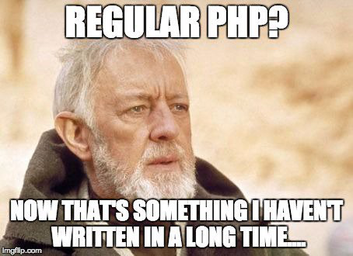

Slide 2


Slide 3
1. PHP

Slide 4
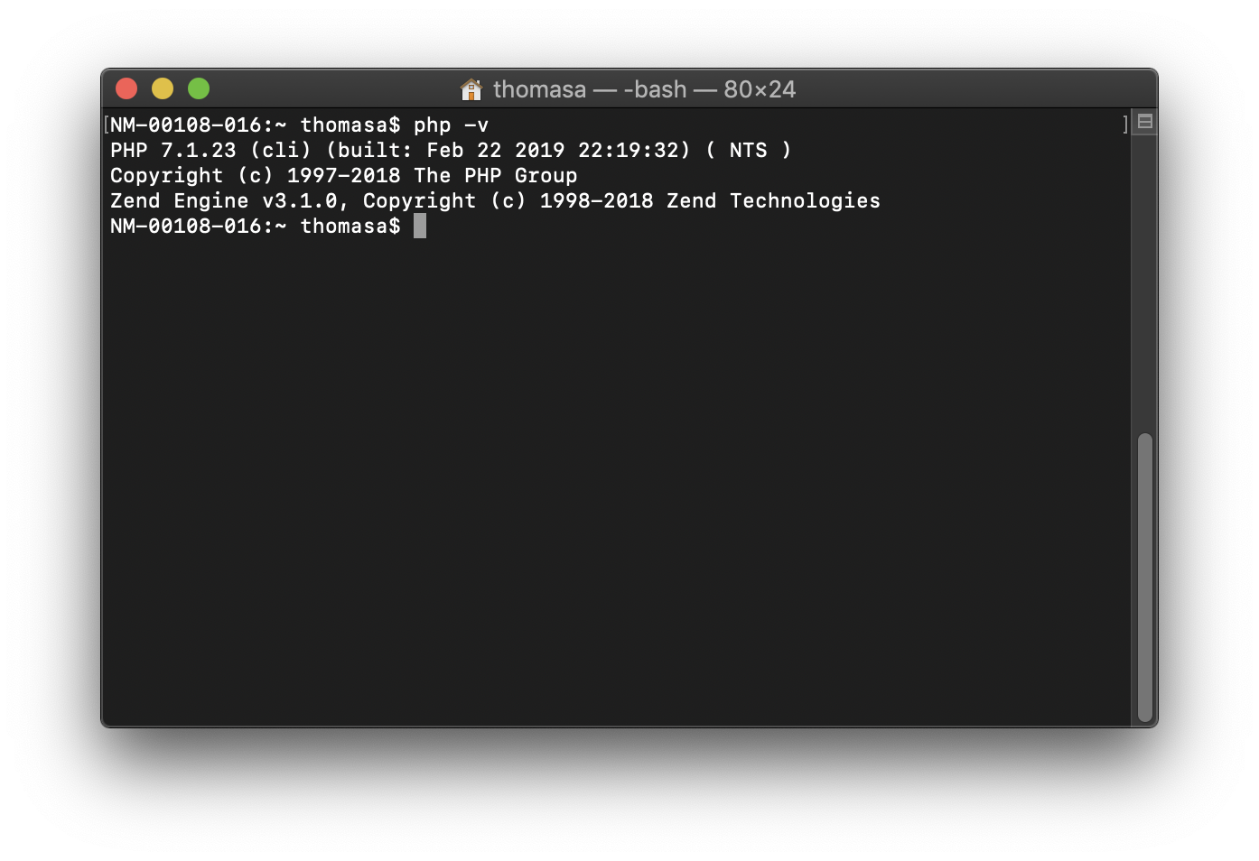

PHP
Open a terminal and check your PHP version:
$ php -v

Slide 5
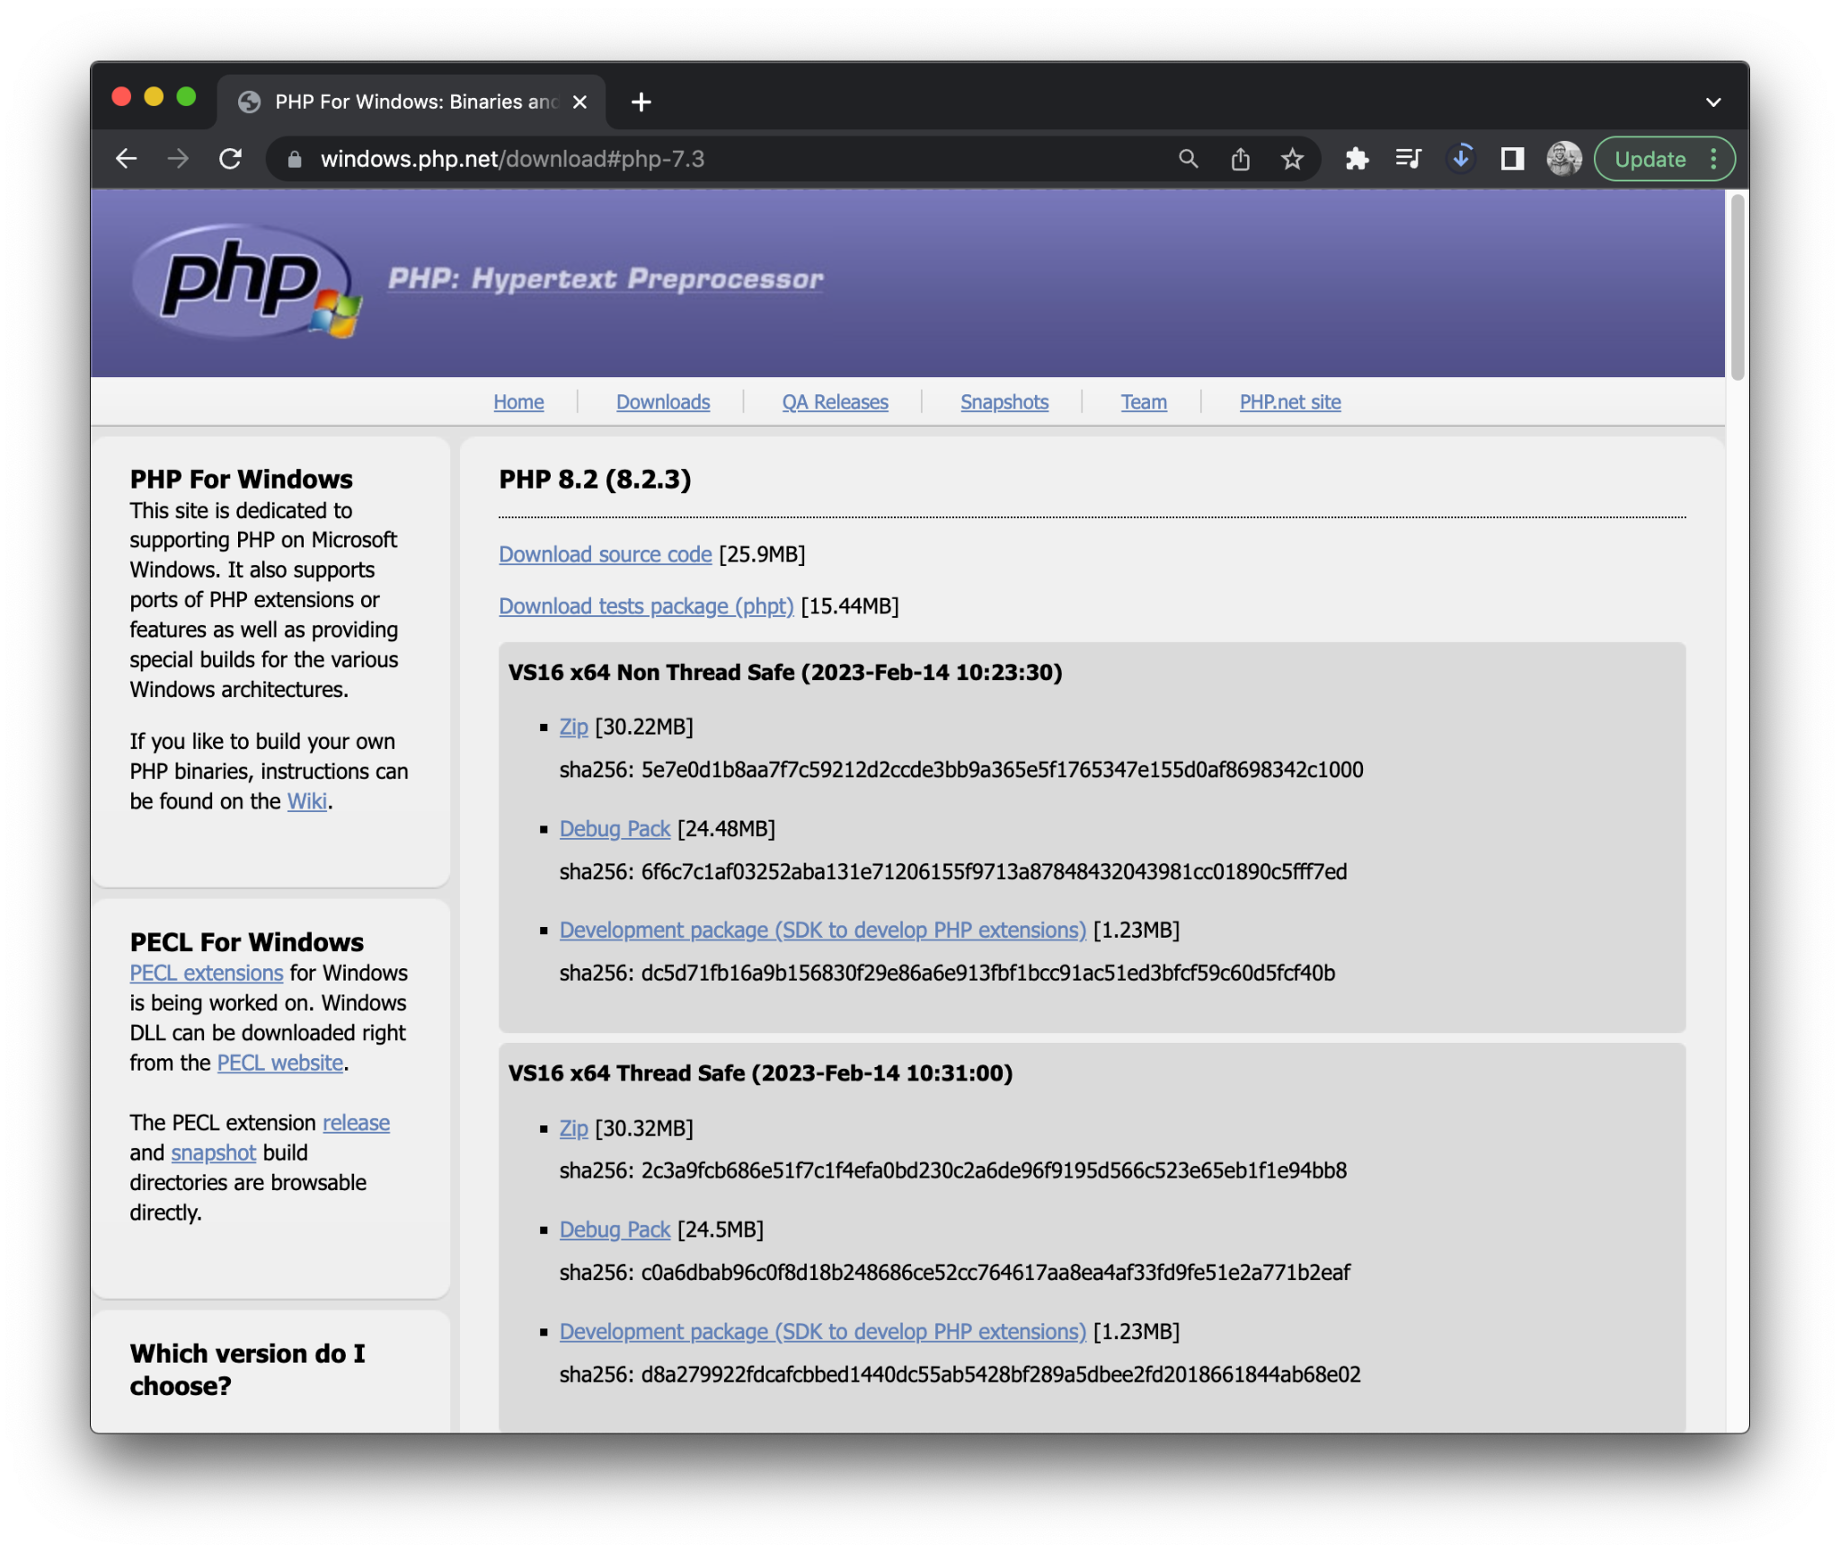
PHP
We need PHP to work at the command line.

Slide 6
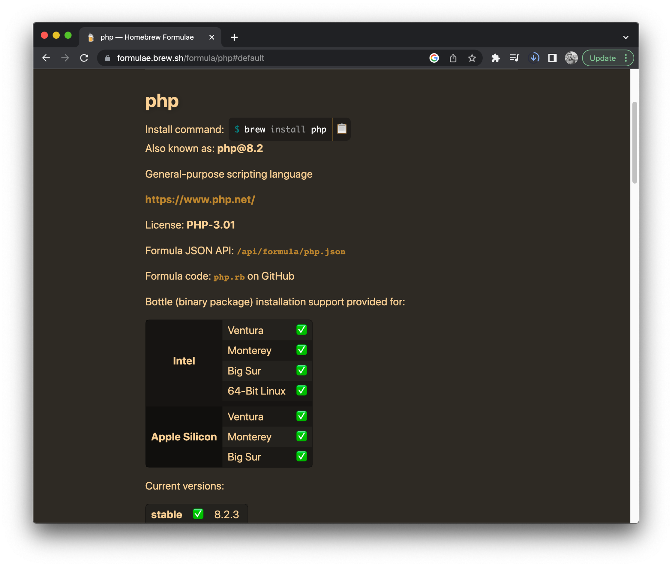

PHP: Mac
On a Mac, use Brew to install PHP:
$ brew install php

Slide 7
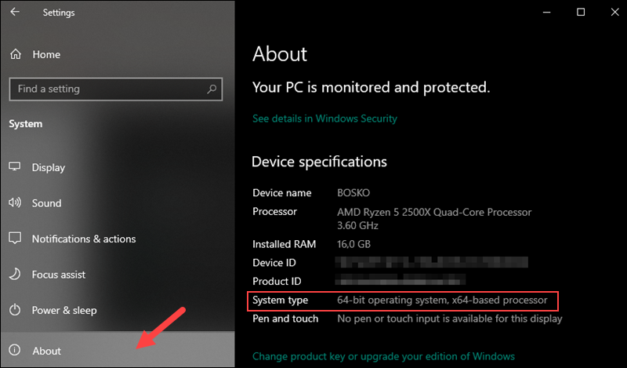

PHP: Windows
Check if your computers is x64 or x86.
Step 1: Open Settings. Step 2: Choose System Step 3: Click About

Slide 8
PHP: Windows
On a PC, download PHP 8.2 (newest), for your computer (x64 or x86).
https://windows.php.net/download
Extract. Rename folder to PHP and place in root.

Slide 9
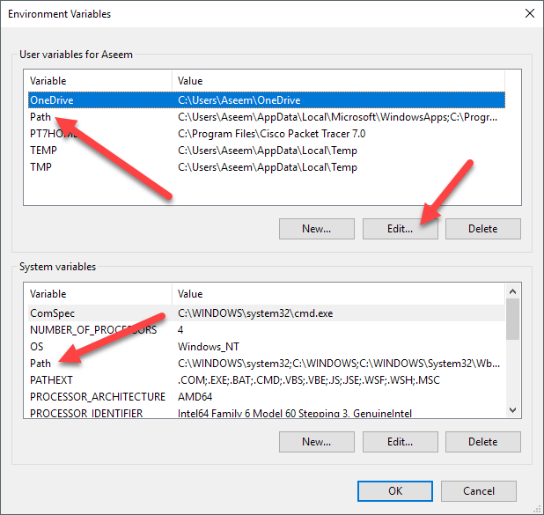
PHP: Windows
Add C:/PHP folder to your Environment Variable Path.
C:/PHP

Slide 10
PHP
Open a terminal and check your PHP version:
$ php -v

Slide 11
2. MAMP

Slide 12
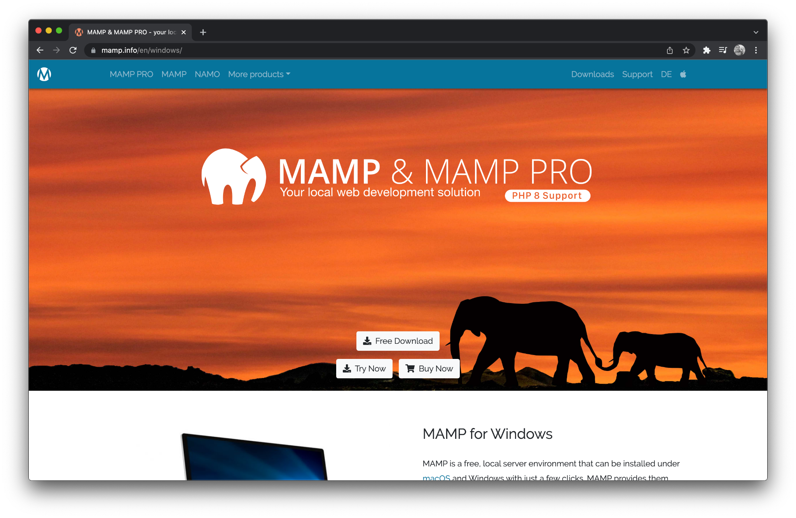

MAMP
MAMP is a free, local server environment that can be installed under macOS and Windows with just a few clicks.

Slide 13
Install MAMP
Install MAMP:
https://www.mamp.info/en/downloads/
Install on a MAC:
https://www.youtube.com/watch?v=gDfUT0Bm2m4
Or on Brew:
$ brew install --cask mamp

Slide 14
Test MAMP
Create a basic webpage. Place it in your MAMP htdocs folder.
Test in a browser:
http://localhost:8888

Slide 15
3. Composer

Slide 16
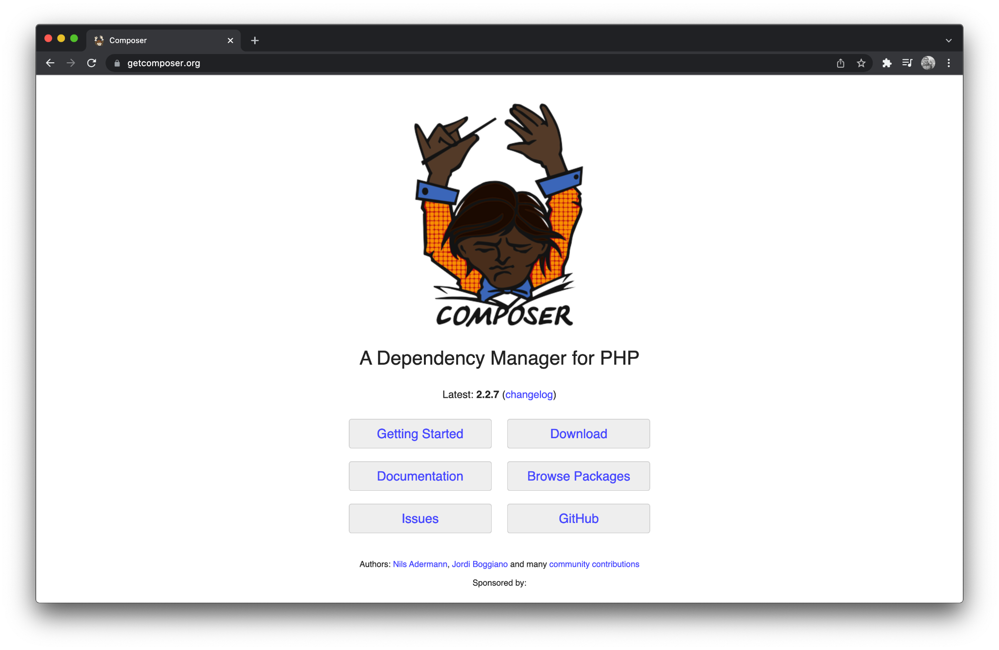

Composer
Composer is an application-level package manager that provides a standard format for managing dependencies of PHP software and required libraries.

Slide 17
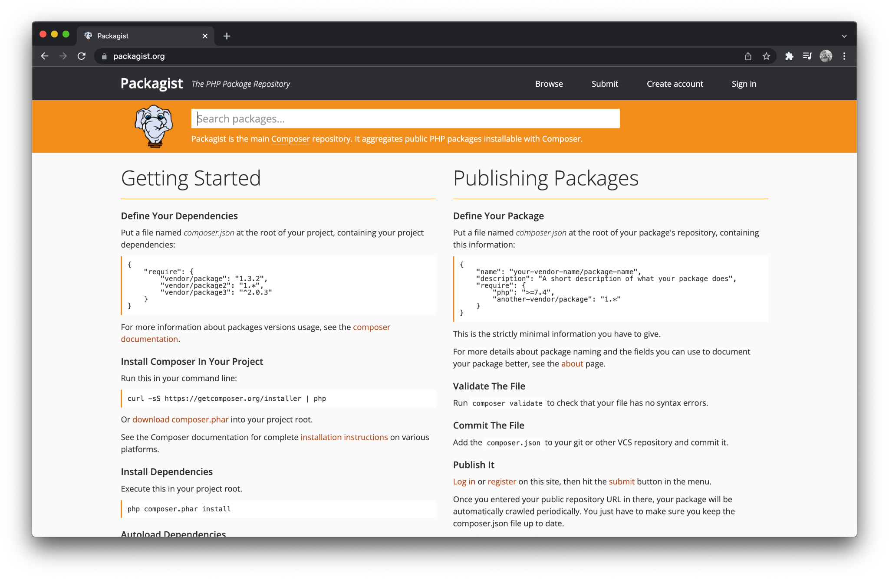

Packagist
Packagist is the main Composer repository. It aggregates public PHP packages installable with Composer.
https://packagist.org/

Slide 18
Install Composer
Install Composer:
https://getcomposer.org/
Install on a MAC:
https://www.youtube.com/watch?v=SgQl0z7PxKk
Or using brew:
$ brew install composer

Slide 19
4. Laravel

Slide 20
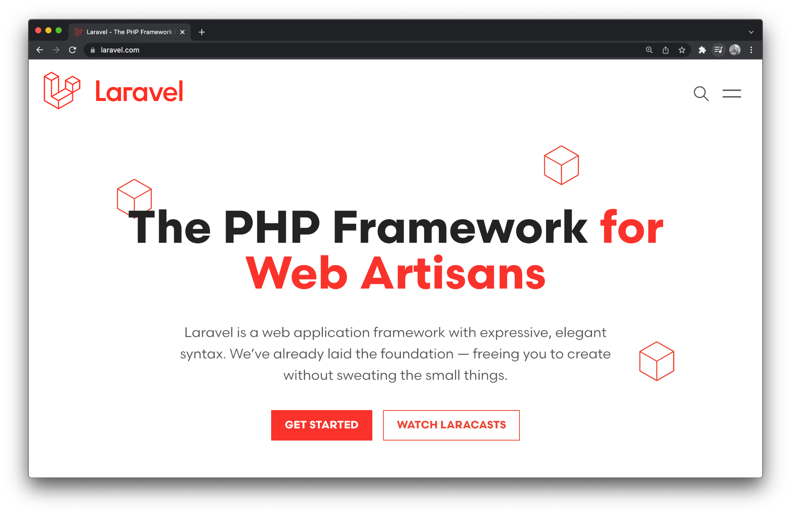

Laravel
Laravel is a free, open-source PHP web framework intended for the development of web applications following the model–view–controller.

Slide 21
Install Laravel using Composer
Install Composer:
https://laravel.com/docs/9.x/installation#installation-via-composer
Install on a MAC:
https://www.youtube.com/watch?v=WBhEhZCPPoY
https://laracasts.com/series/laravel-8-from-scratch/episodes/3

Slide 22
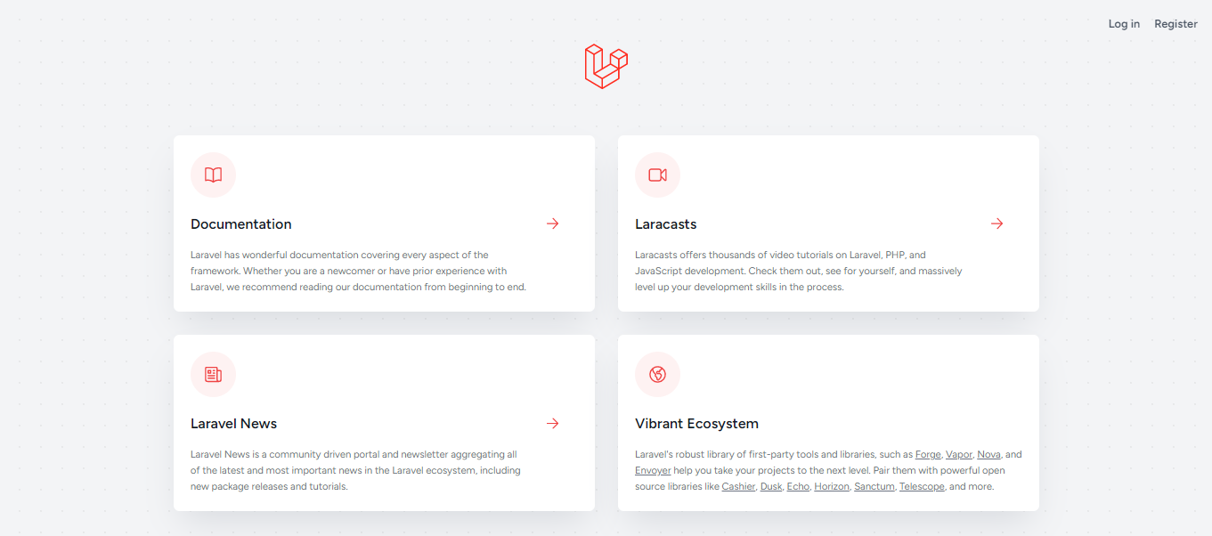
Laravel Demo Page

Slide 23
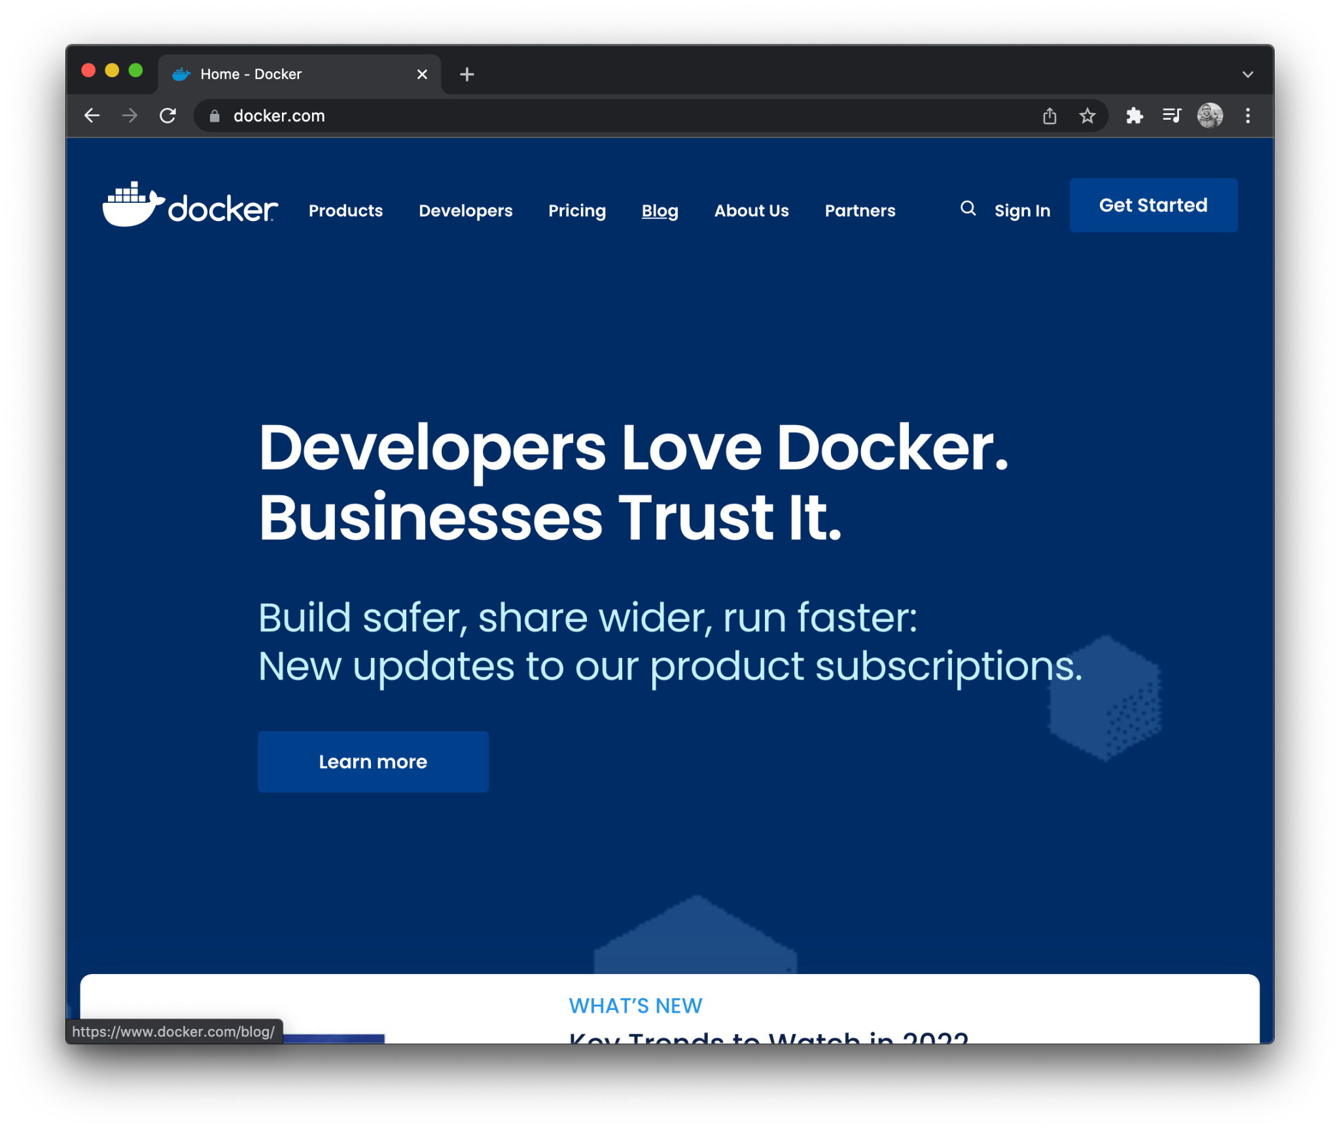

Laravel and Docker
An alternative Laravel method to using MAMP or XAMP, is Docker!
We will cover some Docker basics in Web Development Lab 2.

